Slide 1

Lesson 3: Finding SEO Problems
Kubilay Cagatatay
WEB 225

Slide 2

https://www.barnesandnoble.com/
Barnes & Noble.com leverages the power of the Barnes & Noble brand to offer online customers the Web's premier destination for books, eBooks, magazines, toys & games, music, DVD and Blu-ray, and related products and services.

Slide 3
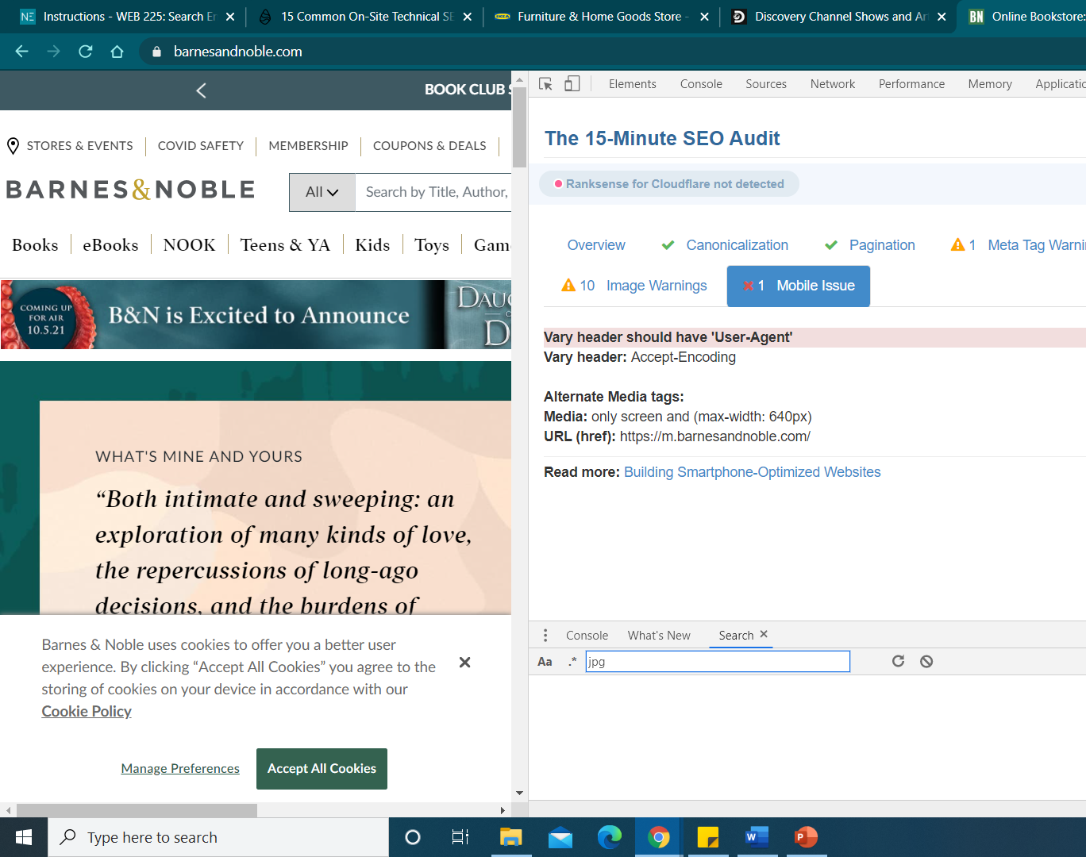
Substandard Mobile Experience
Mobile phone usage is at an all-time high. Last year, there were over 224 million smartphone users in the U.S. alone.
Considering that 40% of web visitors will skip your website if it’s not mobile friendly, you need to optimize your site for mobile and you need to optimize it NOW.

Slide 4

The Solution
Don't block JavaScript, images, and CSS, because Google's search bots look for these elements to correctly categorize the content.
Avoid Flash content and optimize for cross-device conversions.
Design the website so that fat-fingered smartphone users can easily tap on buttons and browse comfortably.
Searches with rich snippets are likely to stand out on mobile devices and attract more clicks, so use schema.org structured data.
Take the litmus-test. Subject your website to these three mobile-readiness tests, and act on the insights you get:
Google Page Insights
Pingdom
GMetrix

Slide 5

https://www.discovery.com/
Discovery Channel is an American multinational pay television network and flagship channel owned by Discovery, Inc., a publicly traded company run by CEO David Zaslav.

Slide 6

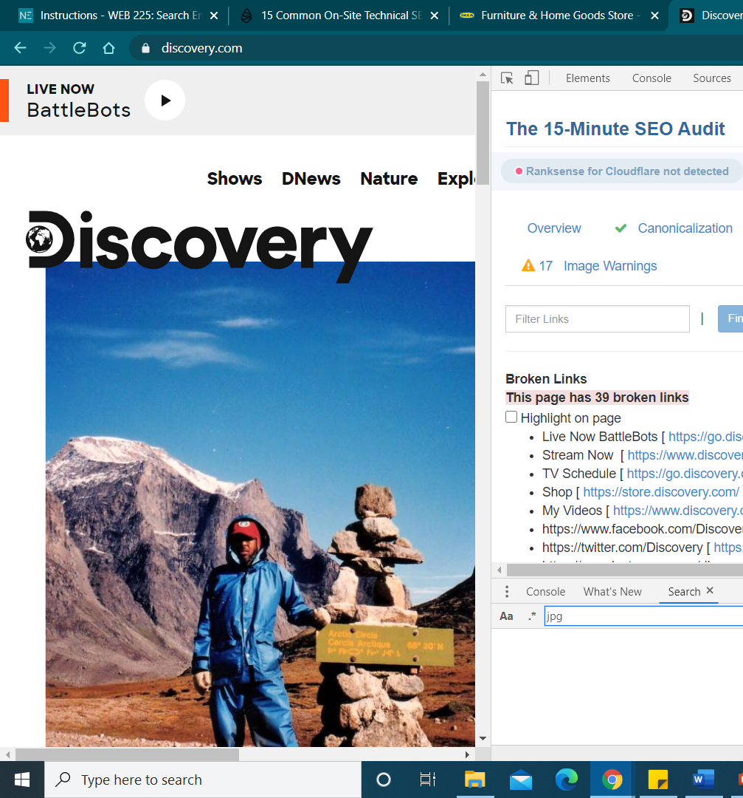
Broken Links
If your website has hundreds of pages, one or two broken links are commonplace and hardly an issue. However, dozens of broken links are a huge blow, because:
The user’s quality perception of your website deteriorates.
Broken links can take your crawl budget for a toss. When search bots find too many broken links, they divert to other websites, which leaves your site's important pages un-crawled and un-indexed.
Your website’s page authority is also negatively impacted.

Slide 7
The Solution
Access the Google Search Console and click on the “Crawl Errors” option under “Crawl” to understand which of your pages are returning 404 responses. Any 404 errors should be fixed early so they do not trouble your visitors and route them to other parts of your website – or off your site all together! – instead.

Slide 8

https://www.ikea.com
IKEA is a Swedish multinational conglomerate that designs and sells ready-to-assemble furniture, kitchen appliances and home accessories, among other useful goods and occasionally home services.

Slide 9
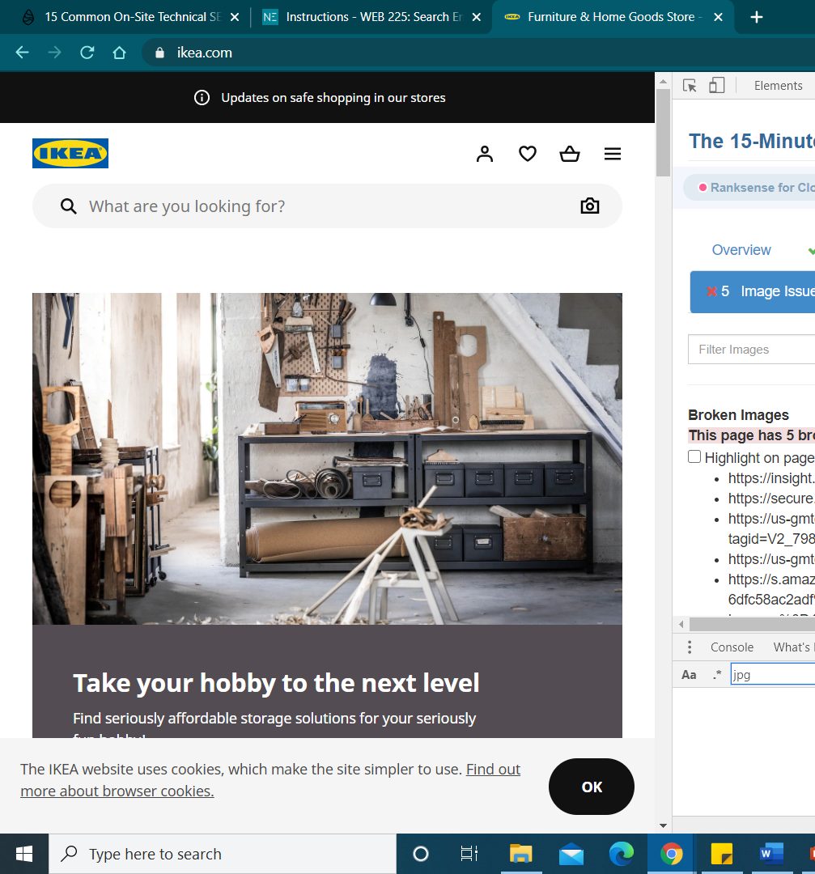
Missing Alt Tags and Broken Images
Problems with image optimization are common, but unless your website is overly reliant on them, you can save them for later. Missing alt tags and broken images are the two most prevalent problems business owners must fix.
Alt tags are HTML attributes to images, describing their contents. If an image component fails to render properly on your website, the alt tag for the image will describe both the contents and the function. They also reinforce the required keyword by helping search engine crawlers understand the page information.

Slide 10
The Solution
Implementing these tags is rather simple. Simply locate the image component in your HTML code and add the alt tag to it.
The image source resembles this:
<img src=“image.jpg” alt=“image description” title=“image tooltip”>

Slide 11

Thank you!

